Slide 1
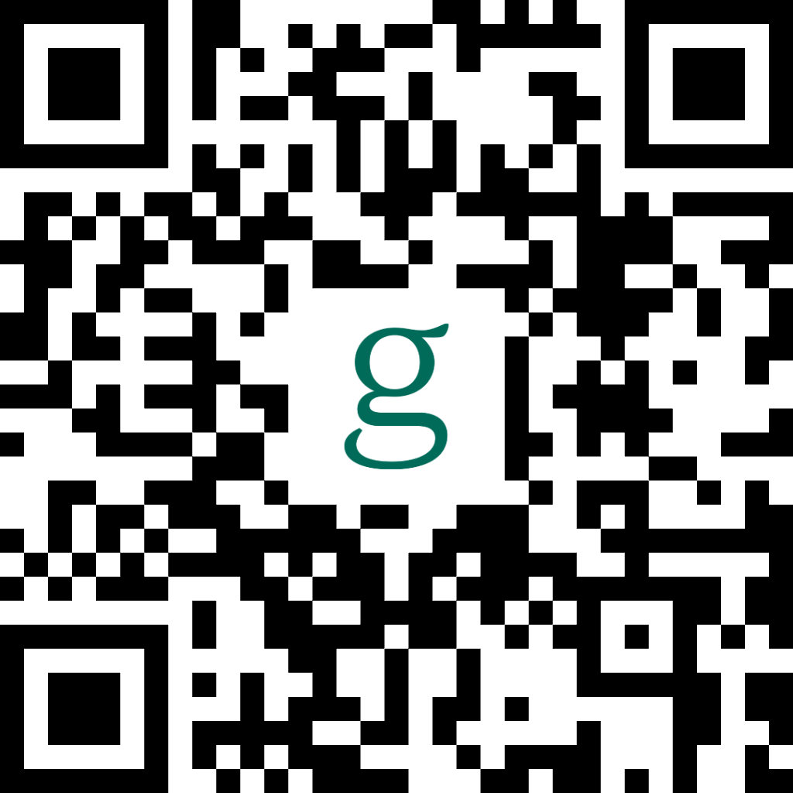
Garner Health New benefit in 2024 for employees and their dependents enrolled in one of the ASC group medical plans.
Garner is a free innovative employee benefit that uses data analytics to help you find the highest quality doctors in the ASC Anthem plan network and helps cover out-of-pocket expenses when you see a Garner Top Provider.
How does it work?
Create a Garner account
Always use your personal phone number for your account. Never use a company home office or facility main number
Login and search for any providers you are currently seeing or search for new providers
Search for any providers you may have upcoming 2024 appointments with
After searching for a provider and confirming they are a Top Provider, the Top Provider will be automatically added to your account
There is nothing further you need to do before your 2024 appointment
Garner contact information:
Garner Health Mobile App
Online at getgarner.com
Email concierge@getgarner.com
Call 866.761.9586
Garner information and materials can also be found on the ASC Employee Benefits Portal
Ascom.mybenefitsinfo.com

