Slide 1
Blended Plan Information American Senior Communities
Savings powered by Imagine360.
Lower costs. Real help. Same great care.
SEPTEMBER 2025

Slide 2

Partnering with you every step of the way.
Ensuring a smooth switch to your new health plan.
You can rely on us to help you with:
Finding Hospitals: You’ll want to find providers that work best with your plan. Even if they aren’t in-network, you can still choose to see them knowing we’ll work to reduce your costs. Our team can help!
Answering Questions: Sometimes, providers may have questions about your plan. Ask them to call the number on your Benefits ID card and we’ll take it from there.
Understanding Hospital Bills: You’ll want to compare your Explanation of Benefits from AmeriBen to any bills you receive. If they don’t match, just call us for support.
As a result, you’ll:
Save Money
Make Informed Choices About Your Care
Have a Partner By Your Side
Notes:
Significant Cost Savings: The extra effort can lead to savings on your healthcare expenses.
Greater Control: You'll have more control over your healthcare choices and costs.
Personalized Care: You can tailor your care to your specific needs and budget.

Slide 3

Member Support
Expert service, education and guidance

Slide 4
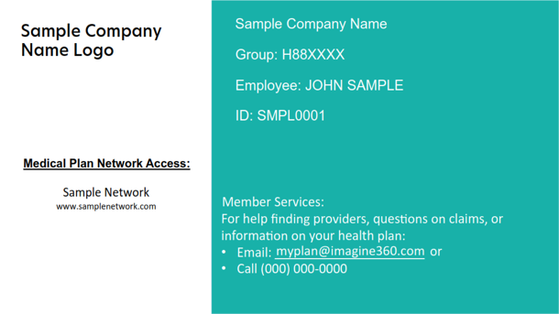
Going to Your Provider
Your Benefits ID card has all the information you and your provider need.
Here are answers to common questions your provider’s office may ask:
What insurance do you have?
“AmeriBen is the claims administrator for my group benefits plan.
How do I confirm your eligibility?
“Simply call the provider number on the back of my Benefits ID card. They’ll verify my benefits, copays and deductibles.”
Always provide it at check-in or registration.
Where do we submit your claims?
“The address for submitting claims is on the back of my Benefits ID card.”
Have questions about your coverage? Call the member number on your card.
Notes:
Your benefits ID card also has a member support line you can always call with questions or issues – even if you’re in you’re in the provider’s office. The only out-of-pocket expense you should pay at the time of service is a copay or deductible (if applicable).
If your provider states they don’t accept your plan please have them contact Member services at the phone number on your Benefits ID Card.

Slide 5

Built-in Price Protection
Steps we take to ensure accurate billing, so you don’t overpay

Slide 6



Our Price Protection ensures accurate billing.
After you receive care, your provider sends us a payment request (a claim).
We review claims to:
Identify billing errors or any incorrect charges.
Limit provider charges to what was negotiated, so you don’t overpay.
Some providers will receive a payment lower than what was billed, but most accept the plan’s payment.
If there’s ever a discrepancy, we will work on your behalf to resolve it! Contact us at the number on your Benefits ID card.

Slide 7
How billing and payment work.
For most claims, it’s as easy as 1, 2, 3.
Claim is reviewed by AmeriBen.
We carefully review it for any errors or overcharges.
1
Provider is sent payment.
We include an explanation of any reductions if the original claim does not match our negotiated pricing.
(Most providers accept this payment.)
2
Employee receives an Explanation of Benefits (EOB).
Employee must pay special attention to the Total Due to Provider. This is the amount owed once the provider sends a bill.
3
If the employee receives a bill and it doesn’t match their EOB, employee notifies AmeriBen, and our team takes over.

Slide 8
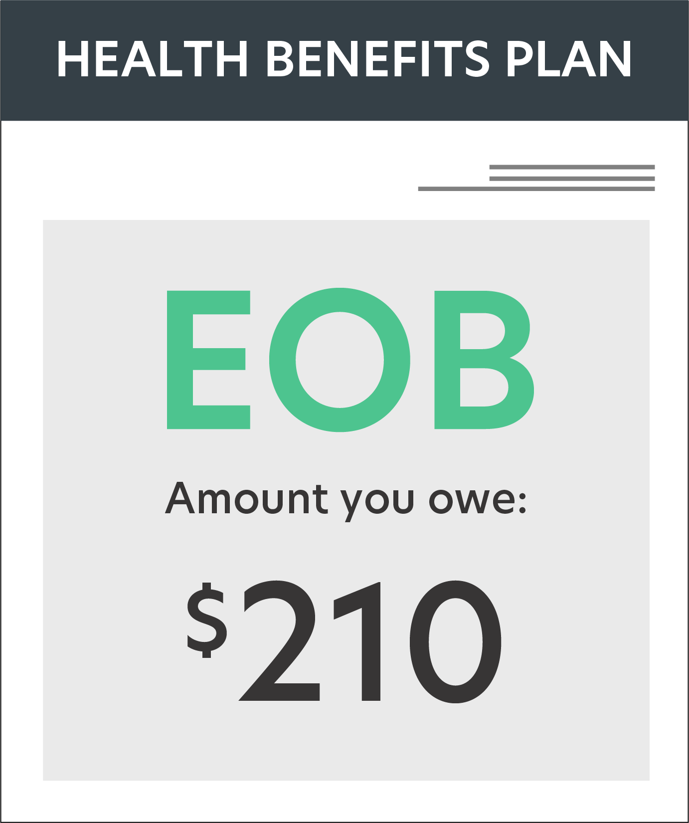
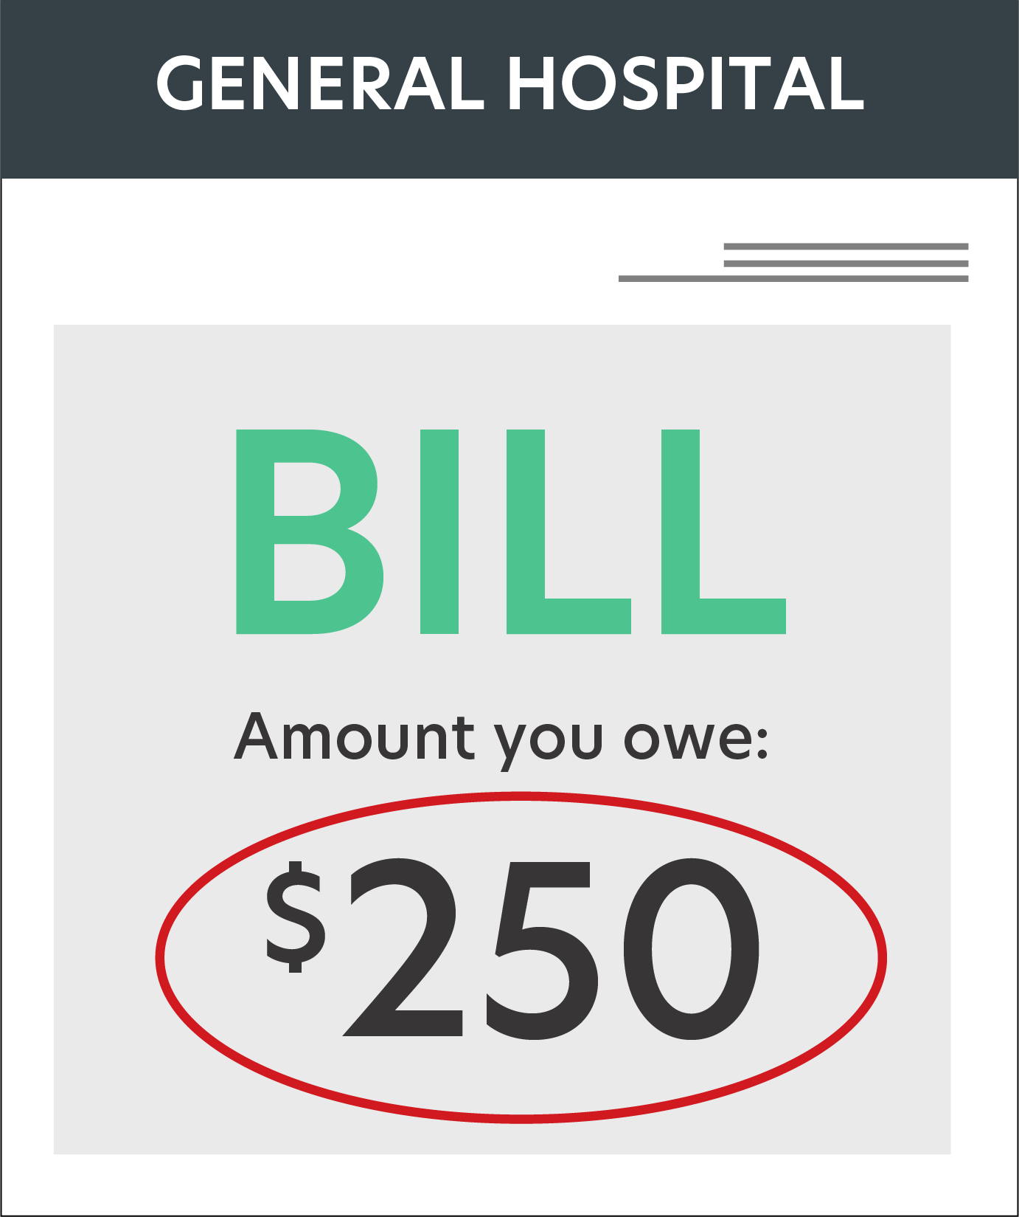

Compare Your Explanation of Benefits (EOB) to Your Provider Bill
Occasionally, a provider may bill you for more than what you owe.
$1,800
From your health plan
(this is not a bill)
From the hospital
If they don't match, you have received a balance bill. Our team is here to help. Contact us at the number on your Benefits ID card.
8
Notes:
So, how do you know if you’ve been balance billed? If you receive a bill from a hospital/facility, the first thing you want to do is locate your Explanation of Benefits. If the amount billed does not match the amount your EOB, says you may owe, you may have a balance bill.
A balance bill is usually the difference between what the provider has billed and the Allowable Claim Limit paid by the Plan. If you think you have a balance bill or are unsure, contact us immediately.

Slide 9

Helpful Tips and Reminders

Slide 10
Helpful Tips About Your Plan
1
Use the Physician & Ancillary Services Card with the Anthem logo anytime you are seeing a physician or laboratory
2
Use the AmeriBen/American Senior Communities without the Anthem logo anytime you are seeking an inpatient or outpatient service, hospitals and imaging services
3
Be sure to open all the mail you receive from your provider or hospitals and make sure the amount they are billing you is the same that is on your Explanation of Benefits (EOB). If it isn’t call the number of the back of your ID card and tell them you may have received a balanced bill. They will confirm if that is the case or not. If it is a balance bill, you do NOT owe any more money other than what is stated on your EOB.
4
If you live in Fort Wayne, Indiana and Parkview Hospital is important to you for any facility service other than emergency services, you should consider enrolling in the Traditional offering.
5
If you live in Richmond, Indiana, and Reid Health is important to you for any facility service other than emergency services, you should consider enrolling in the Traditional offering.
When in doubt, call the number on the back of your ID card
6
If you encounter a concern by a provider, please have them call the number on the back of your ID card.
7
Approved Partners: The Provider Access Team, may reach out to you in the event a concern by a provider has been encountered.

Slide 11



3 Things to Remember
Call the member number on your Benefits ID card.
If you have any questions, or are simply unsure, call the number on your card
Review all provider bills.
Compare them to your EOBs and call AmeriBen if any bills don’t match. Remember, you ONLY owe the amount on the EOB.
Use the Physician & Ancillary Services Card with the BCBS logo anytime you are seeing a physician or laboratory
Use the AmeriBen/American Senior Communities card without the BCBS logo anytime you are seeking an inpatient or outpatient service

Slide 12

Welcome to AmberiBen & Imagine360

